Slide 1

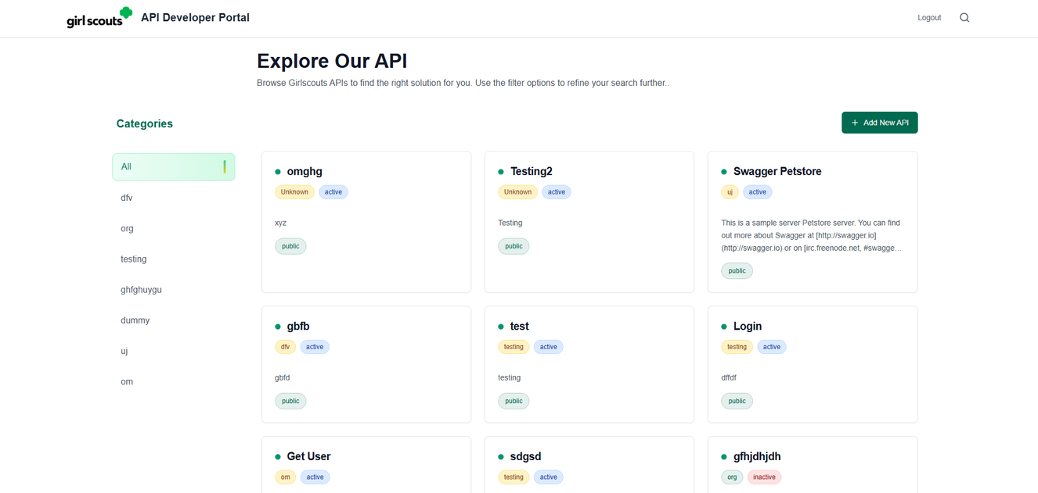
API DEVELOPER PORTAL — GIRL SCOUTS
Product Overview & UI Walkthrough
Presented by [Your Name] | [Your Position] | [Your Company]

Slide 2
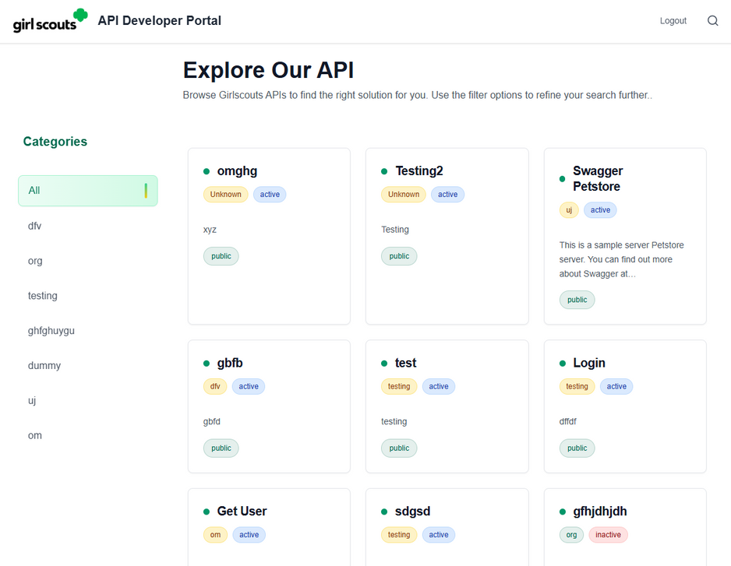
Product Goal & What It Solves
Centralized API discovery: Find all available APIs in one place
Faster developer onboarding: Clear flow from sign-up → login → catalog → docs
Reduced confusion: Categories + clean navigation to locate APIs quickly
Quicker integration: Documentation view helps developers start using APIs faster
Consistent experience: Same portal UX for users and admins (role-based access)

Slide 3
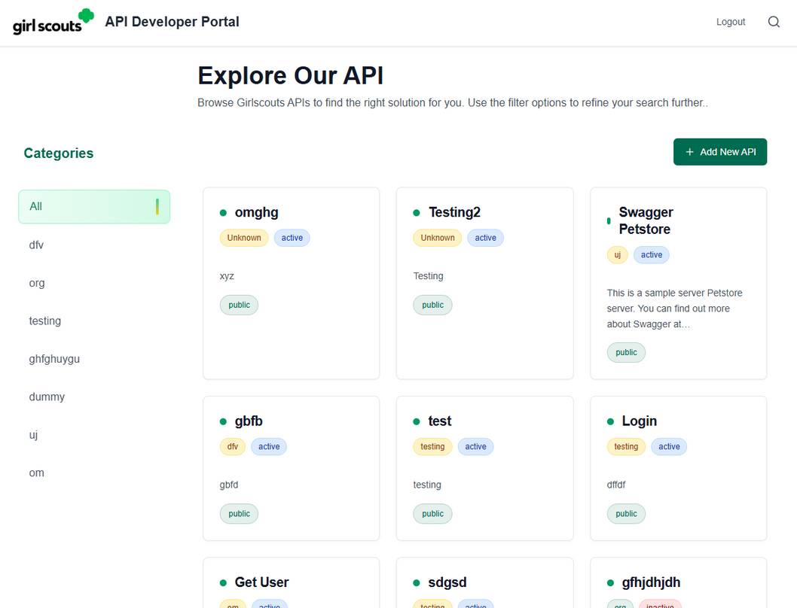
Role-Based Access (User vs Admin)
User Access: Browse API catalog and view API documentation
Admin Access: Same portal experience + Add New API (admin-only)
Controlled permissions: Actions are allowed based on assigned role
Secure flow: Login required before accessing portal pages
Consistent UI: Same layout for both roles to reduce learning curve

Slide 4
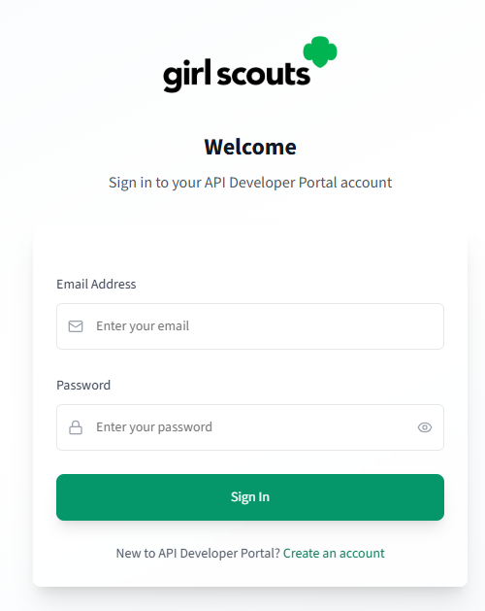
Authentication & Onboarding
Simple access flow: Register → Login → Enter Portal
User Registration: email + password + confirm password validation
Login: secure sign-in with role-based redirect
Admin Setup: protected invite-code based registration (/admin-register)
Clean UI focused on fast onboarding for developers

Slide 5
Catalog Browsing (User Portal)
Browse APIs in a clean card-based catalog
Filter quickly using the Categories sidebar
See key info at a glance: name, short description, status/visibility (active/public)
Use search to find the right API faster
Open any API card to view full documentation

Slide 6
Admin Dashboard
Same catalog browsing experience as the User Portal
Admin-only: “Add New API” button for creating new entries
Admin can manage API listings (create/update/organize)
Role-based permissions ensure only admins can perform changes

Slide 7
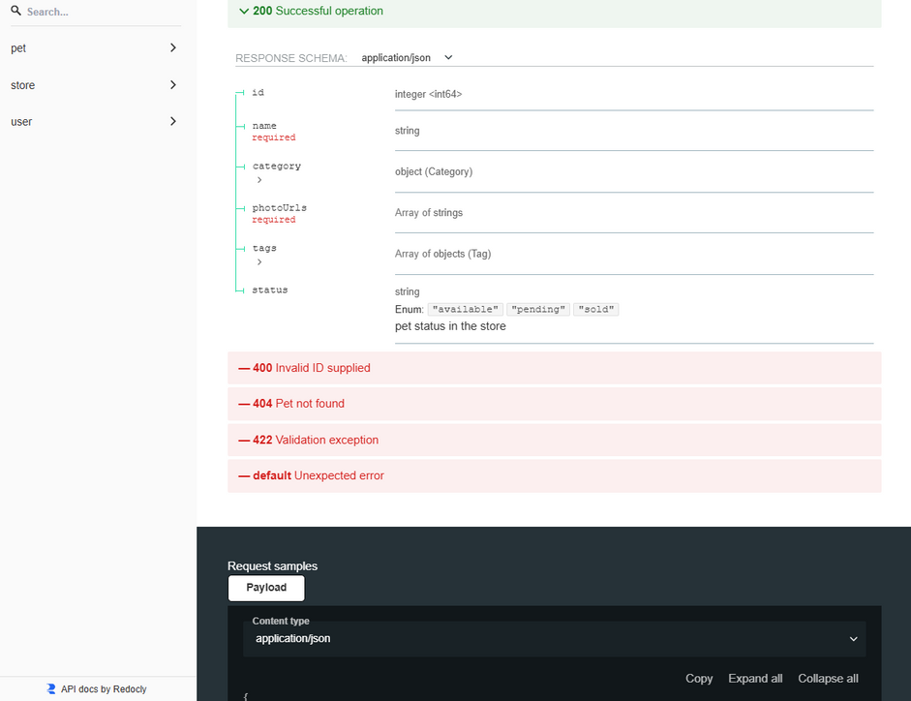
API Documentation
Swagger/Redoc-style documentation for each API
Endpoints grouped for quick navigation
Response samples and schemas reduce integration time
Helps developers test and understand APIs faster

Slide 8
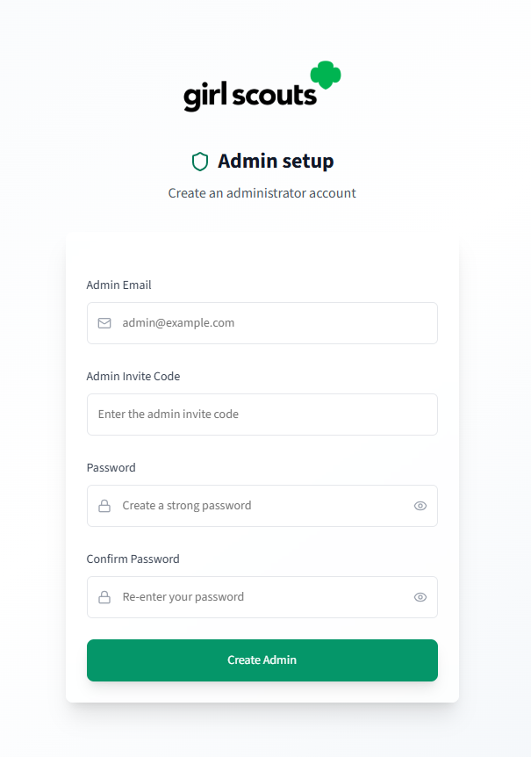
Security & Control
Protected routes (authenticated access only)
Admin access restricted via invite-based setup
Role-based permissions for safe admin actions
Consistent access control across portal screens

Slide 9
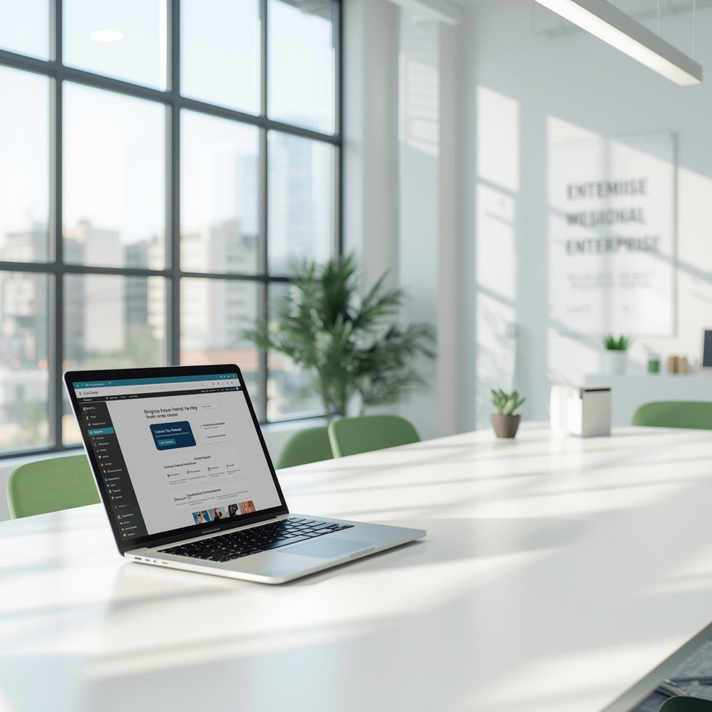
Thank You
CONTACT US
123 Anywhere St., Any City, ST 12345
123-456-7890
hello@reallygreatsite.com

